Slide 1
Earthquake data visualization
Data allocation on geographical map
How many data record my each location
Parameter correlation of earthquake data

Slide 2
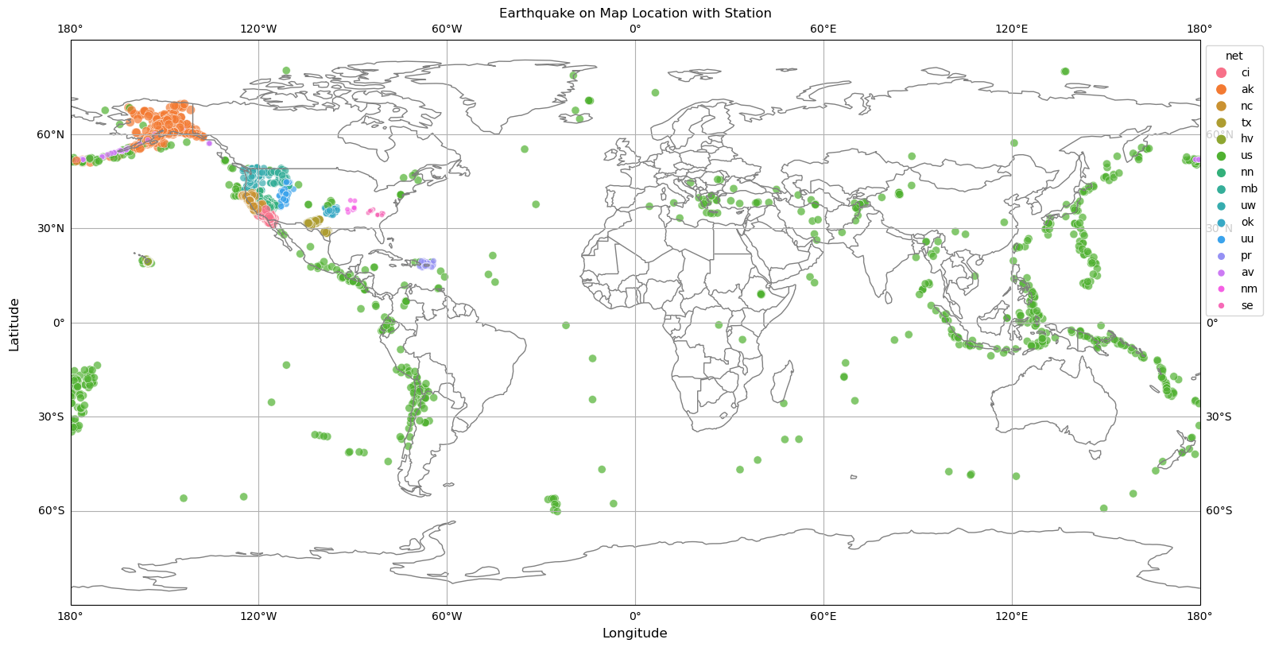

Slide 3
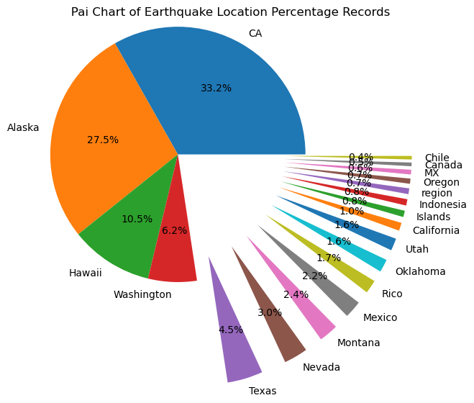

Slide 4
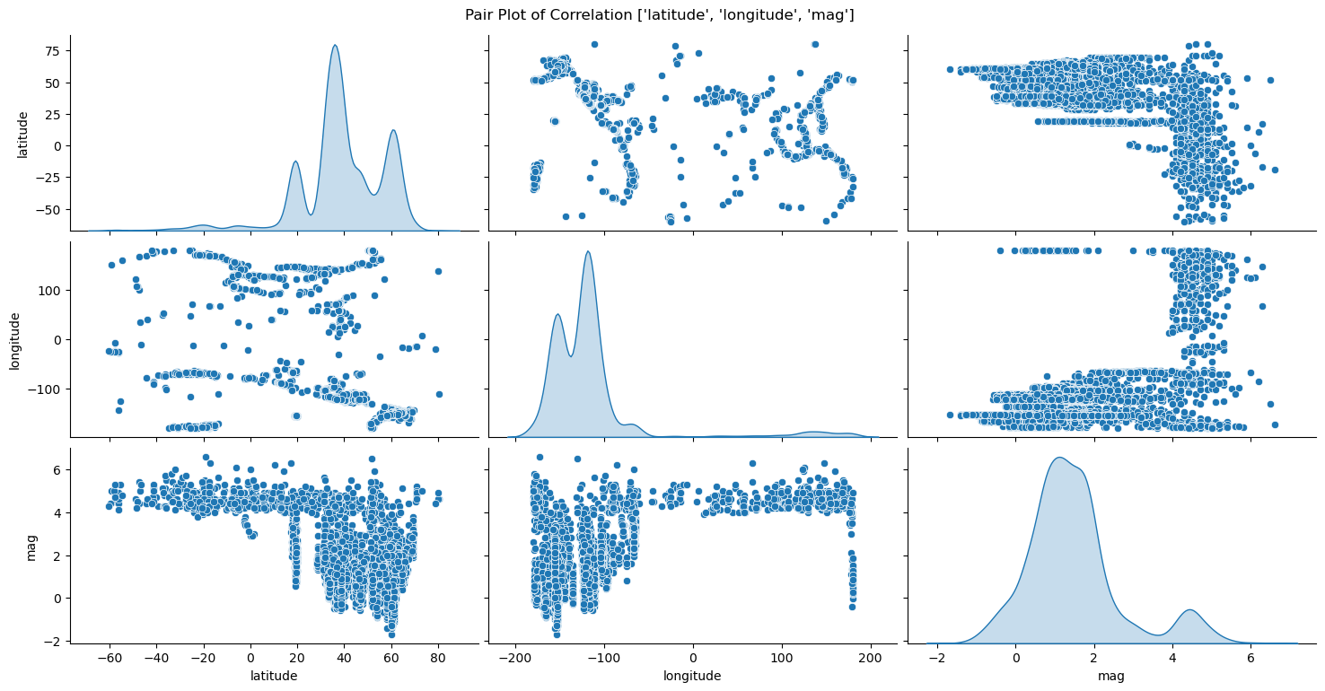

Slide 5
Insight of presentation
Display of all Earthquake recorded location of data on Mercator world projection map
Top 3 highest recorded data from California, Alaska and Hawaii region and its cover more then 70%, so might data is US centric
Highest correlations of Magnitude with Latitude ( 0 to 80) and Longitude (-50 to -200) because most data fall between West cost of pacific ocean

